Slide 1
E-Commerce & Retail B2B Case Study
Mini Saxena
Prudhvi Mounika Mythri
Neha Manjrekar

Slide 2
Problem Statement & Business Goals
Schuster is a multinational retail company dealing in sports goods and accessories. Schuster conducts significant business with hundreds of its vendors, with whom it has credit arrangements. Unfortunately, not all vendors respect credit terms and some of them tend to make payments late. Schuster levies heavy late payment fees, although this procedure is not beneficial to either party in a long-term business relationship. The company has some employees who keep chasing vendors to get the payment on time; this procedure nevertheless also results in non-value-added activities, loss of time and financial impact. Schuster would thus try to understand its customers’ payment behaviour and predict the likelihood of late payments against open invoices.
Goals:
Schuster would like to better understand the customers’ payment behaviour based on their past payment patterns (customer segmentation).
Using historical information, it wants to be able to predict the likelihood of delayed payment against open invoices from its customers.
It wants to use this information so that collectors can prioritise their work in following up with customers beforehand to get the payments on time.

Slide 3
Payment Process at Schuster
Every time a transaction of goods takes place with a vendor 🡪 the accounting team raises an invoice and shares it with the vendor.
This invoice contains the details of the goods, the invoice value, the creation date and the payment due date based on the credit terms as per the contract.
Business with these vendors occurs quite frequently. Hence, there are always multiple invoices associated with each vendor at any given time.

Slide 4
Methodology
Reading and Understanding the data
Data Cleaning and Preparation
Handling Missing Values
Handling Outliers
Data Cleaning
Exploratory Data Analysis
Univariate Analysis
Data Imbalance
Bivariate Analysis
Feature Engineering
Dummy Variable creation
Clustering
Model building
Train- Test Split
Feature Scaling
Logistic Regression
Plotting the ROC curve
Random Forest
Hyperparameter Tuning
model evaluation
Checking feature importance
Final Prediction based on Random Forest model

Slide 5
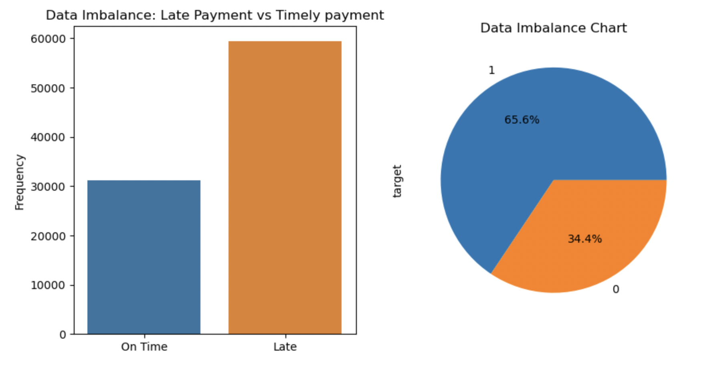
Dataset Properties
Dataset has total 16 columns and 93937rows.
There are total 12 object values, 1 integer value int64 & 3 float values.
Outliers
Null values : The "RECEIPT_DOC_NO" col has 0.03% null values. Dropping the columns as it is not important for model building.
Target variable : Derived by checking whether the payment receipt date falls within, or after the due date.
Data Imbalance : 65% of the total payment was late payment.

Slide 6
EDA Received_Payments_Data.csv Open_Invoice_data.csv

Slide 7
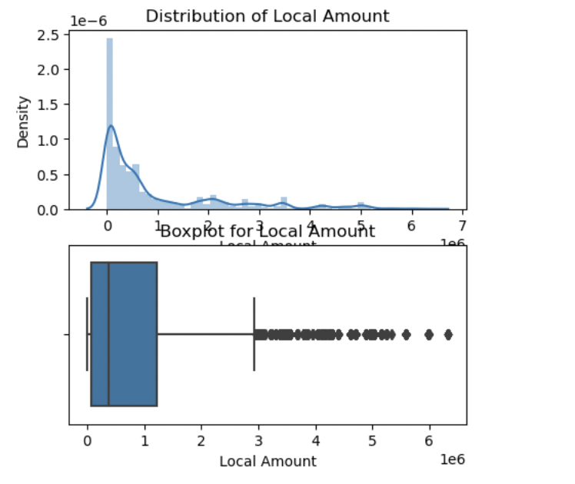
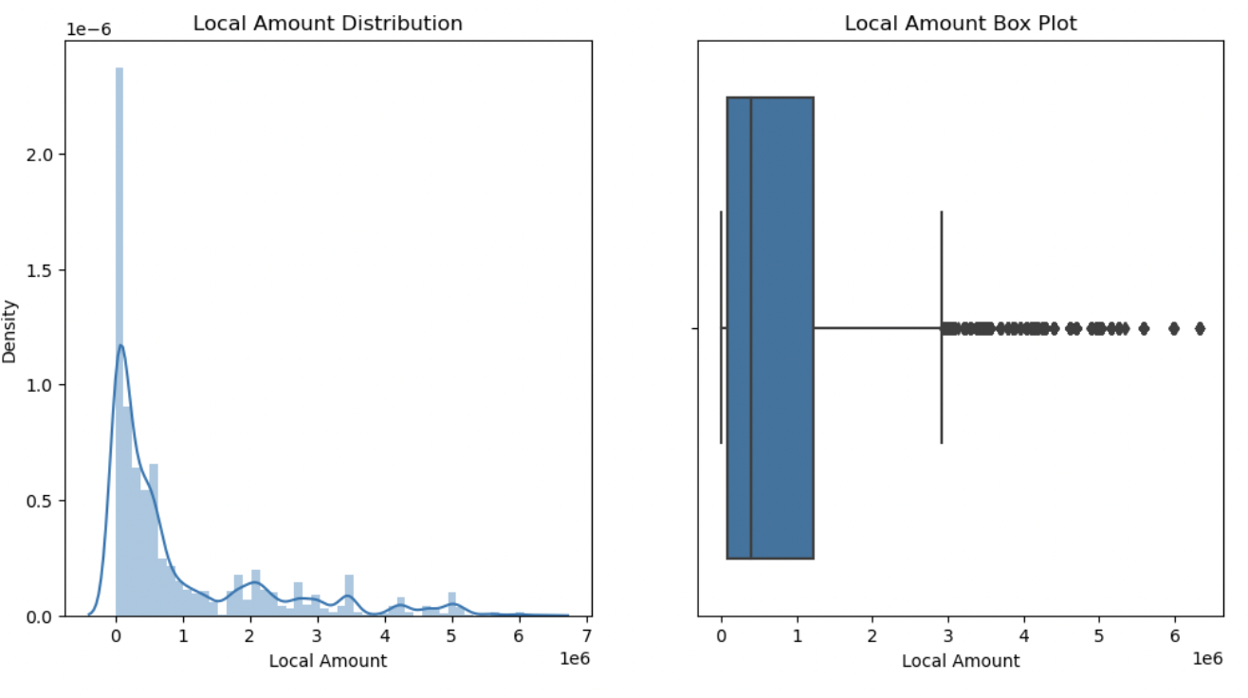
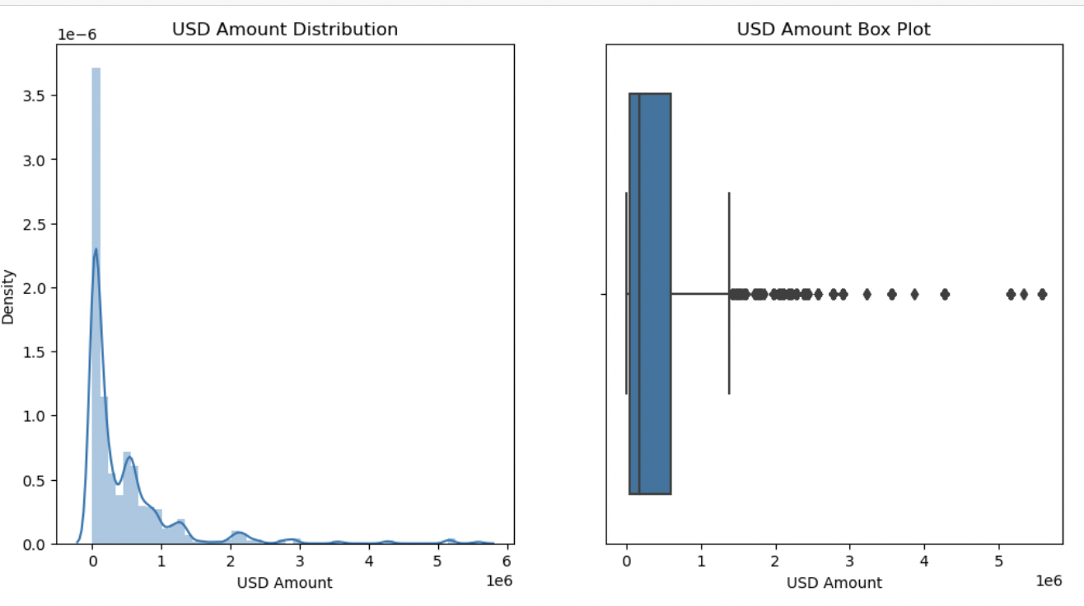
Visualizing the distribution of local & USD amount
The transaction values seem to lie between a range of $1 and $2m and are most frequent below ~$1.75m

Slide 8
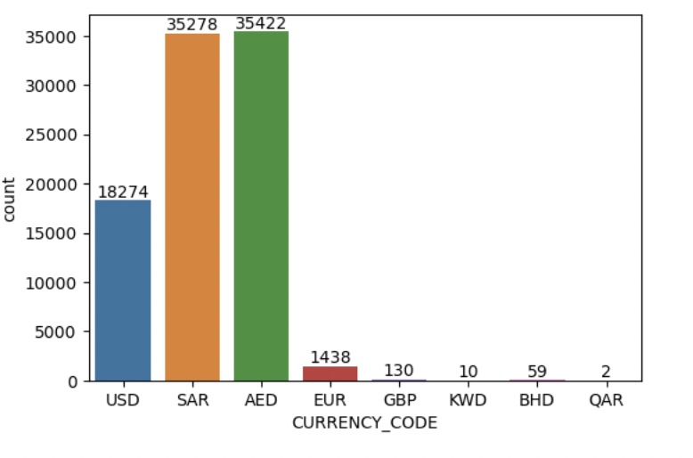
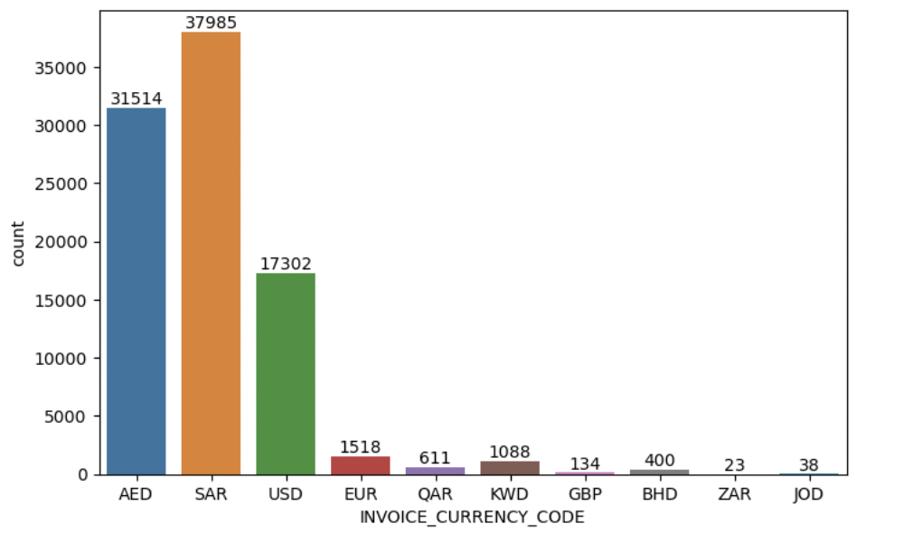
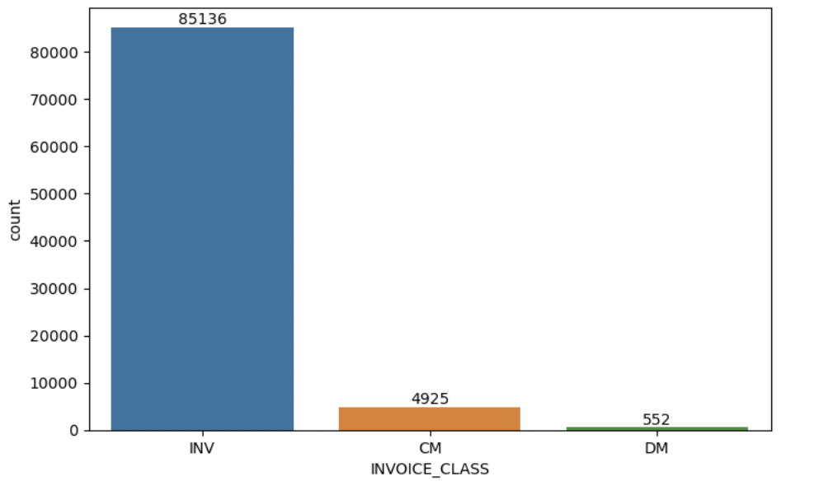
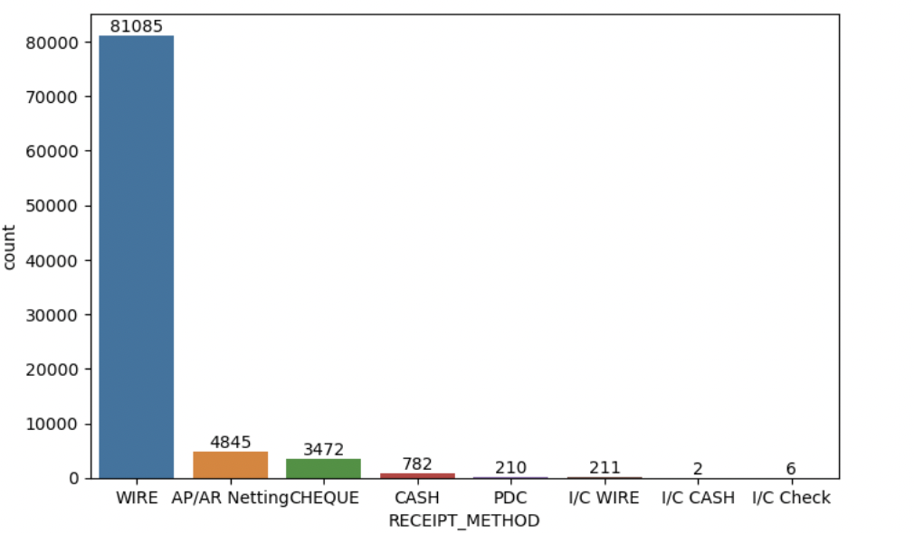
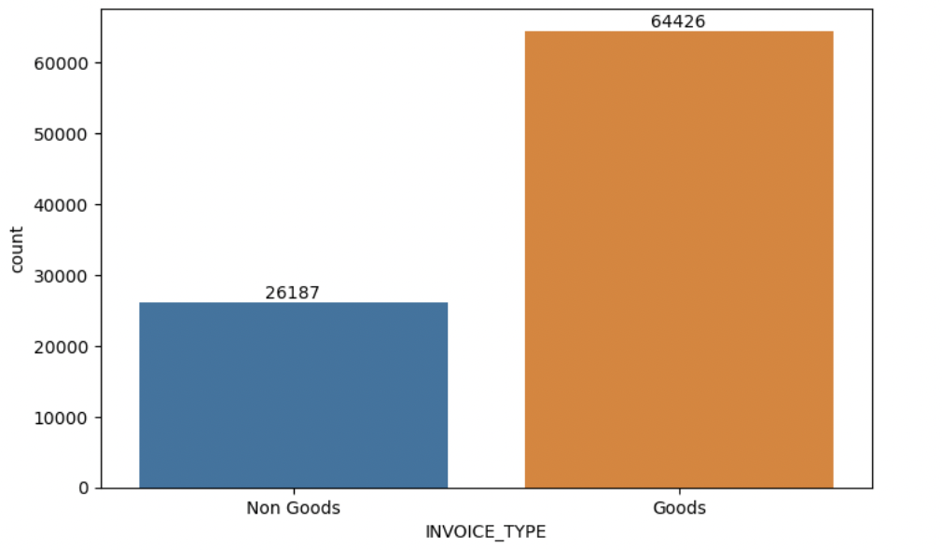
Analyzing Numeric Variables
Currency used for bill payments are mostly USD, SAR or AED.
INV has the maximum number of bills in INVOICE_CLASS column.
Majority of the invoices are raised for Goods.
The most preferred payment method for bill payment is WIRE.

Slide 9
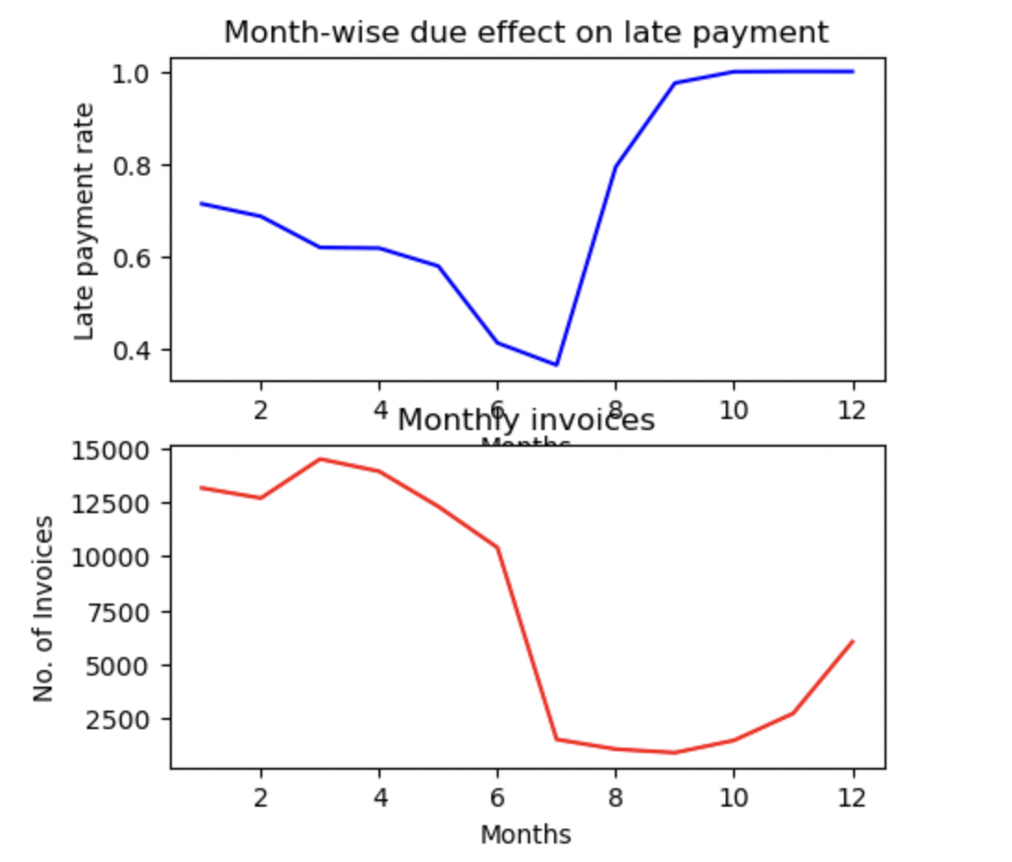
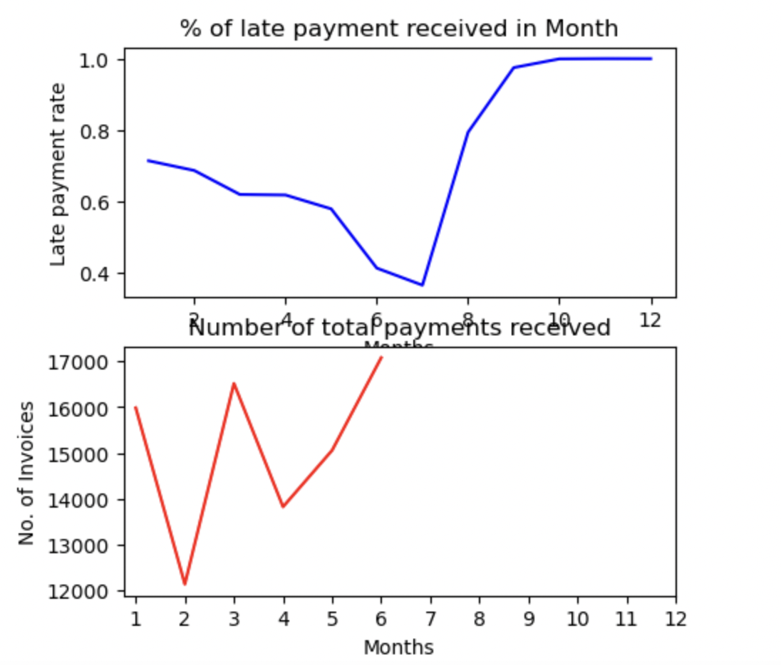
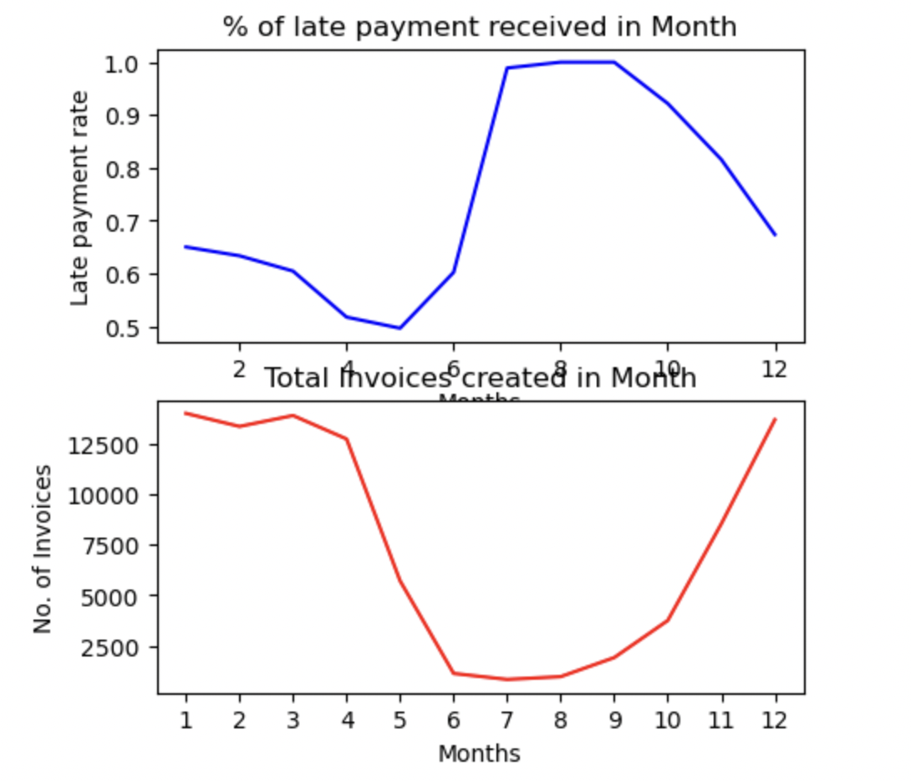
Effect of month on late payment rate
For the 3rd month, the number of invoices is the highest and late payment rate is comparatively lower than other months with large number of invoices.
Month 7 showed very low late payment rate this might be because of the number of invoices is also low.
In the 2nd half of the year, the late payment increases steeply from 7th month onwards. The number of invoices are comparatively lower than the first half of the year.
No payment received against any invoices from 7th month onwards.
Late payment rate is decreases from 1st to 5th month.
For the months 7, 8 and 9, the late payment rate is very high.

Slide 10
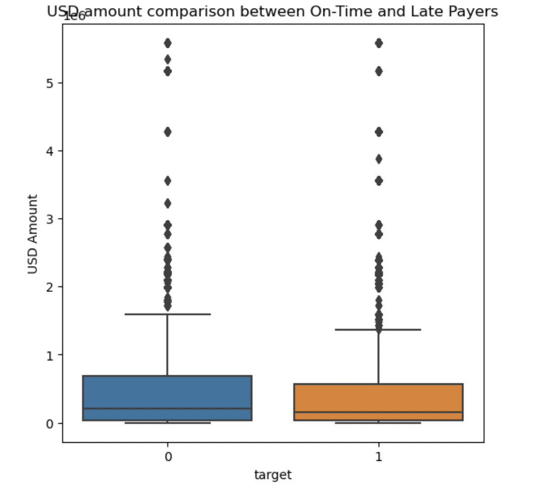
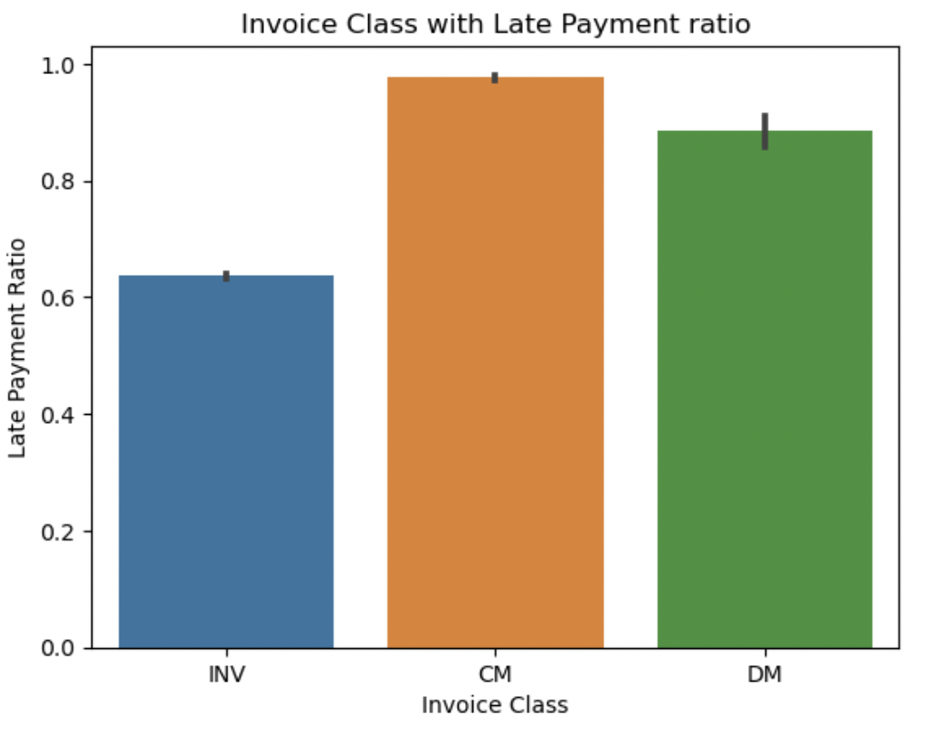
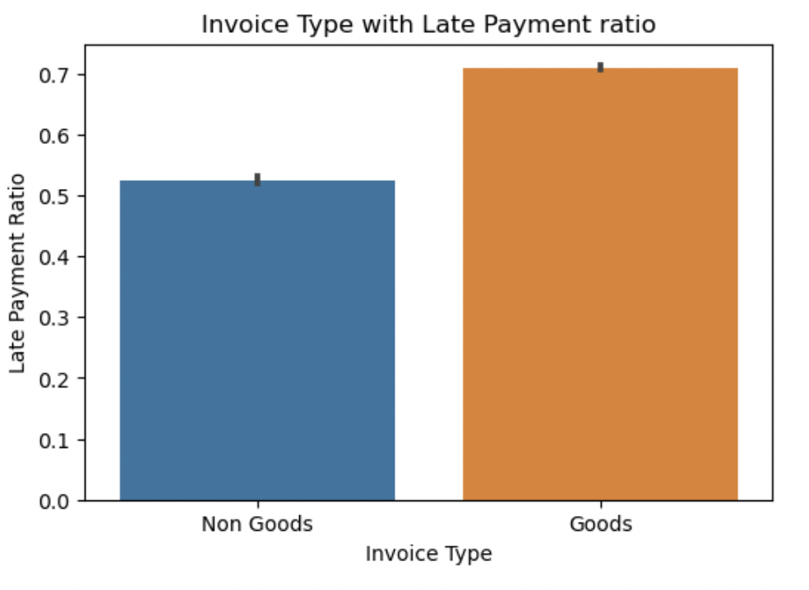
Analyzing Late Payers
The Median of on time and late payer is more or less the same.
Credit memo has the higher late payment ratio.
Majority of the invoice type was for Goods.

Slide 11
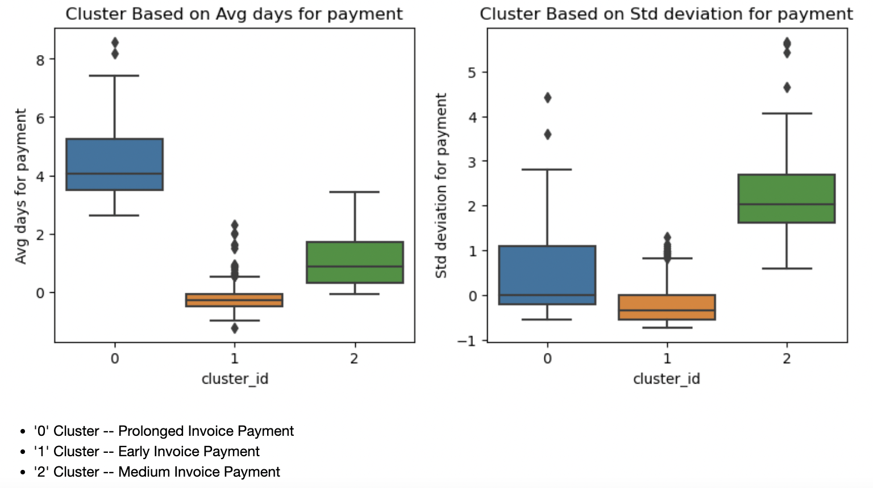
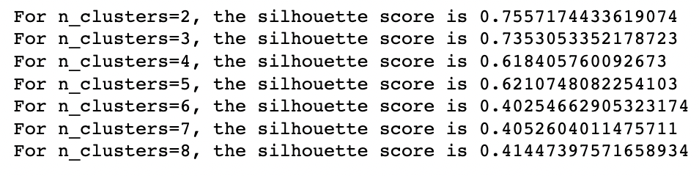
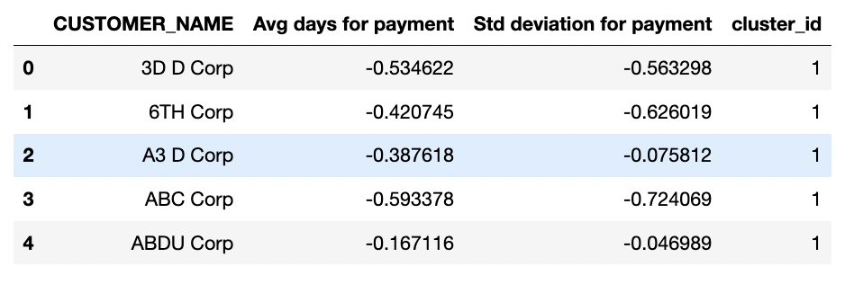
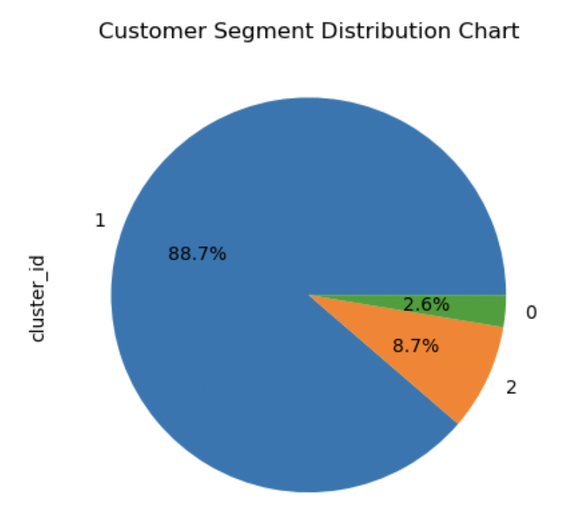
Clustering
From the above results, we can see that for 3 clusters, the silhouette score is decent. Hence selecting n_clusters as 3.
Median for prolonged invoice payment is higher than Early invoice payment .
From the above we can see that Early customers comprise of 88.7% of customers whereas medium and prolonged payers are 11.3% in total
Assigning labels to the cust_seg dataframe

Slide 12
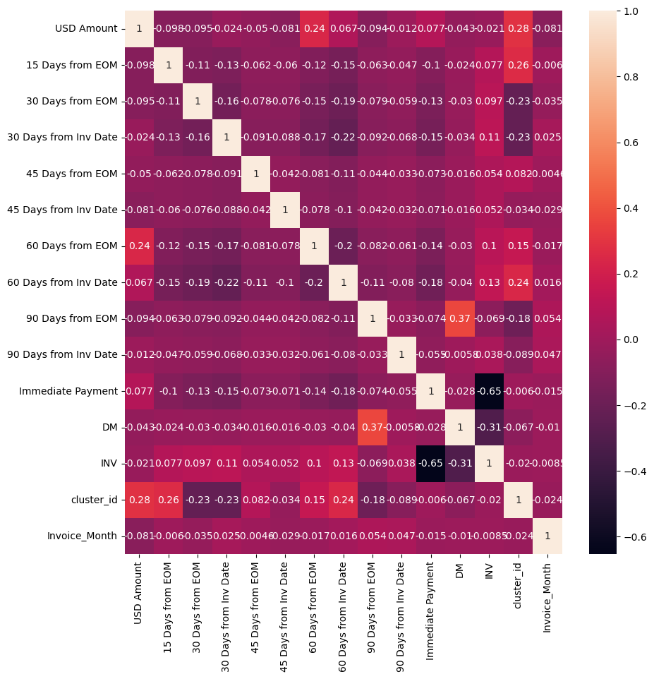
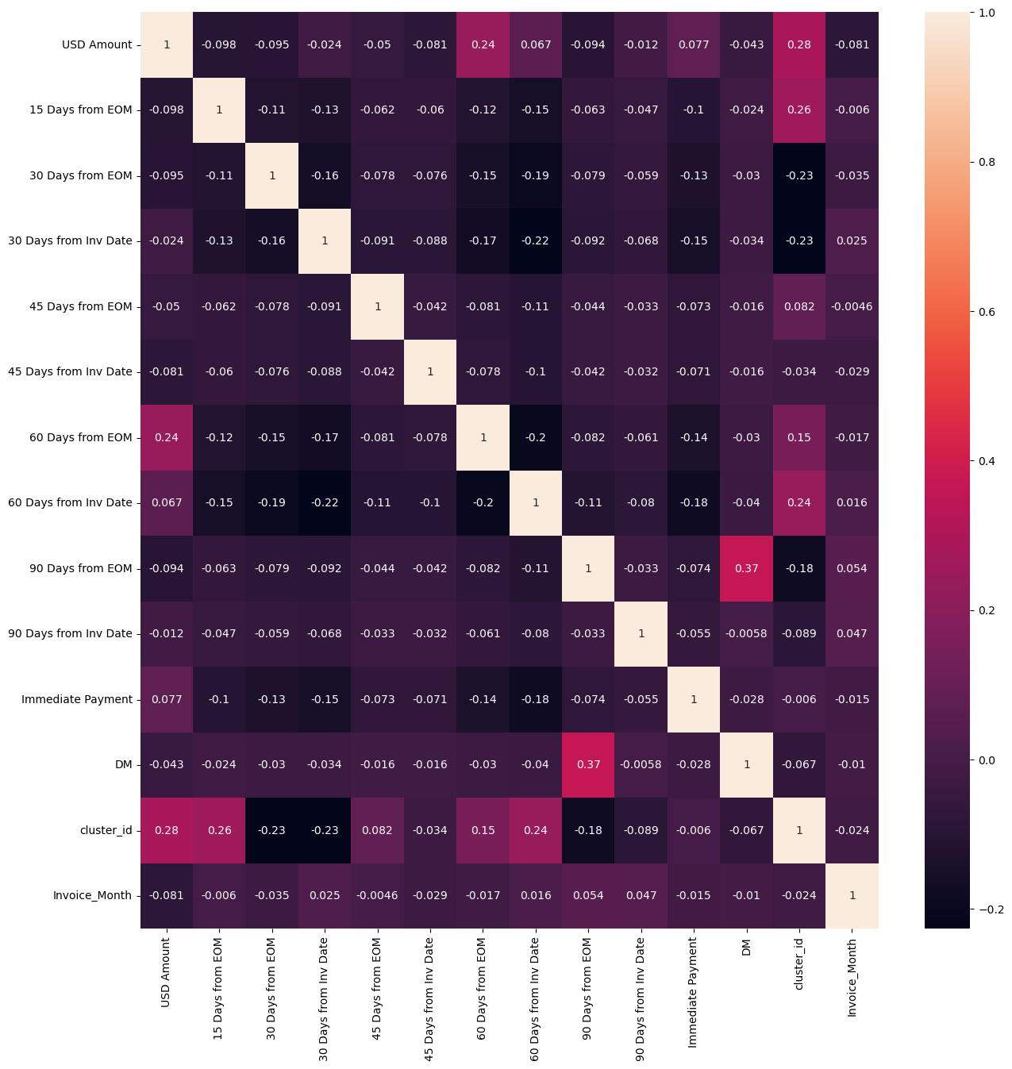
Heat map of X_train dataset
Before dropping dropping INV -
INV & Immediate Payment has high multicollinearity
After dropping INV – data has no high multicollinearity.

Slide 13
Model Building

Slide 14
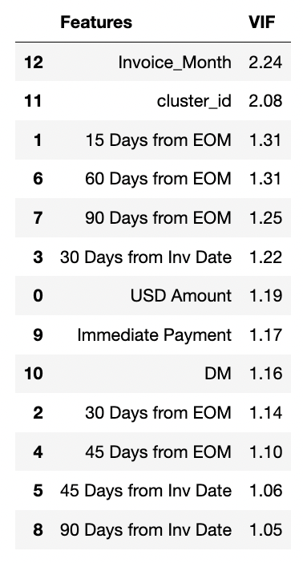
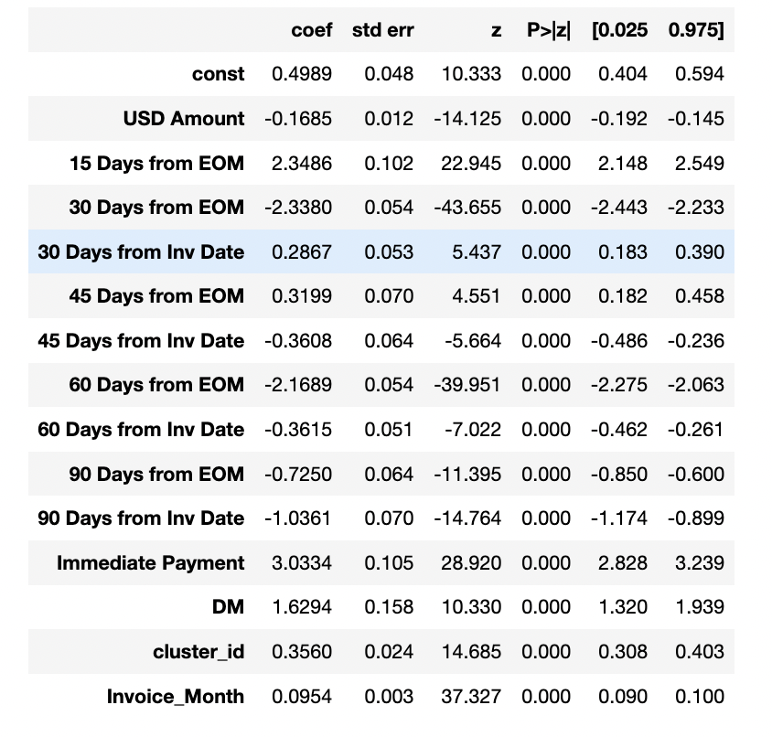
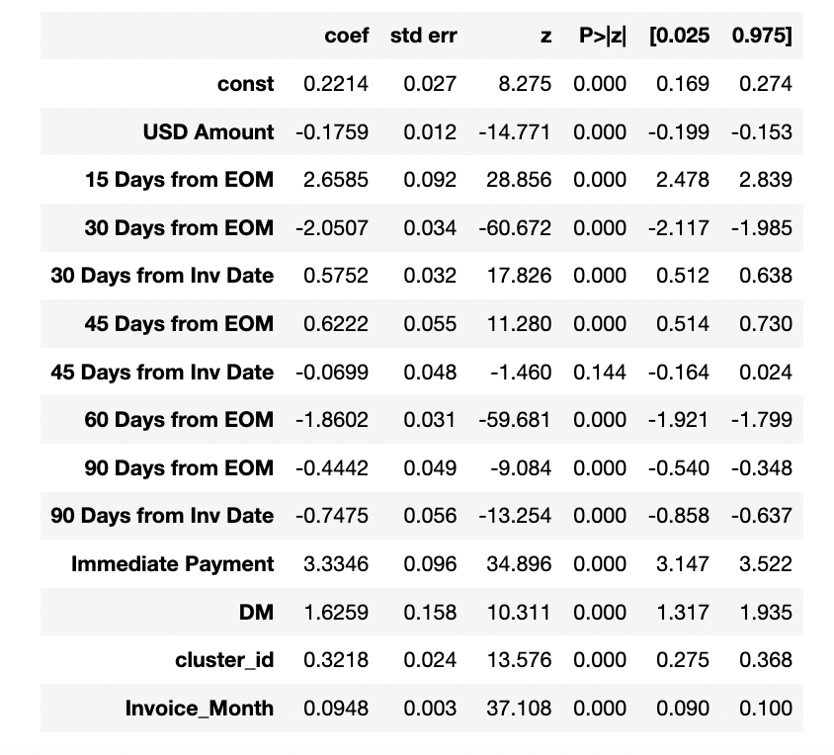
Model Building
Final features
1st Model
2nd Model
After checking 1st Model we performed manual feature elimination of '60 Days from Inv Date’
Final model has 13 features .
All the P value VIF are in accepted range.
We used this model to make predictions on traning and testing data set.

Slide 15
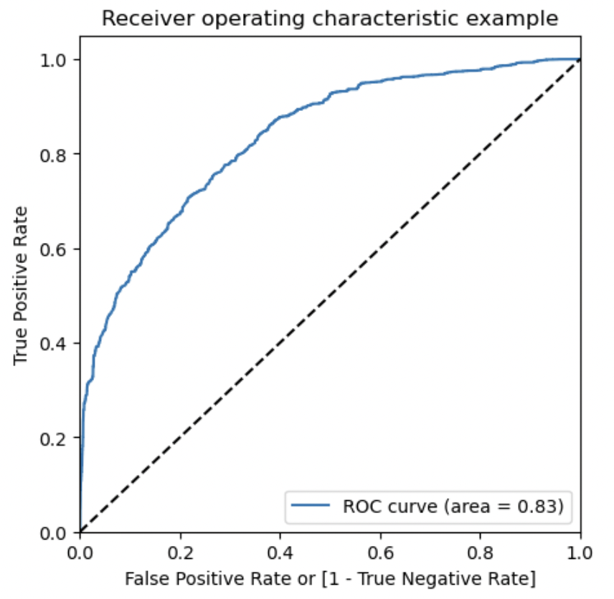
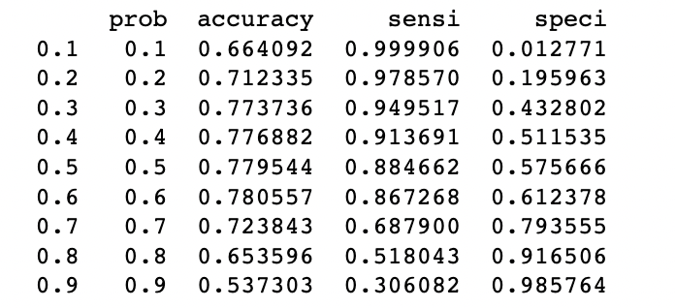
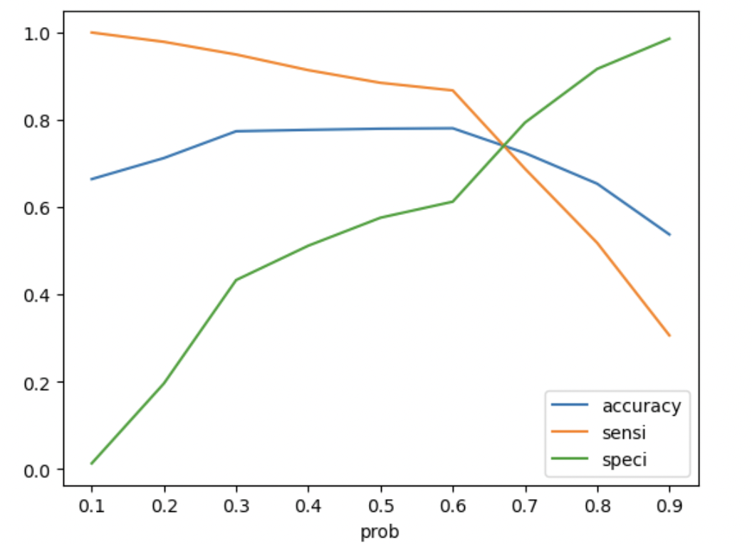
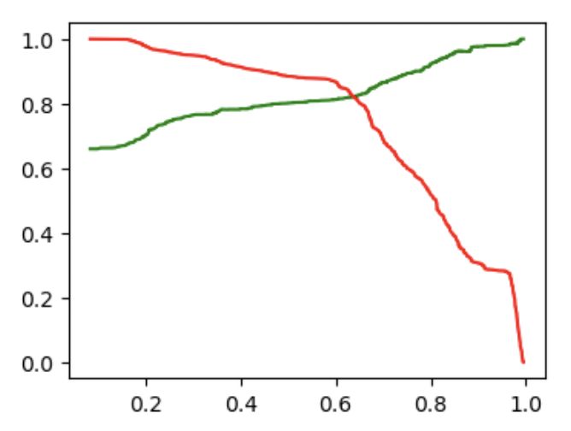
Model Evaluation and Observation
From the curve, 0.6 is the optimum point to take it as a cutoff probability.
On Precision & Recall trade off we found optimal cutoff of between 0.6 & 0.7 . Hence keeping the optimal cutoff 0.6.
AUC = 0.83 which shows the model is good.
Our train and test accuracy is almost same around 77-78 %

Slide 16
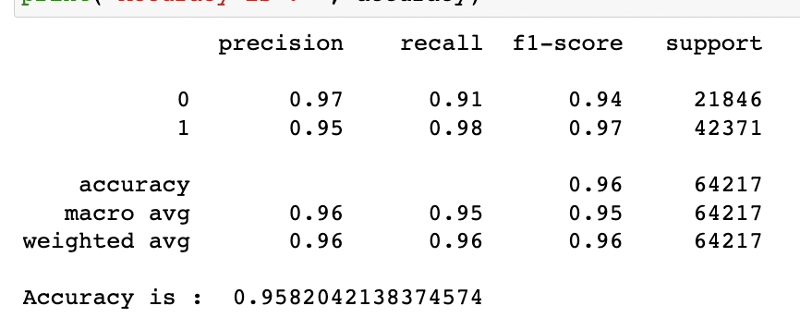
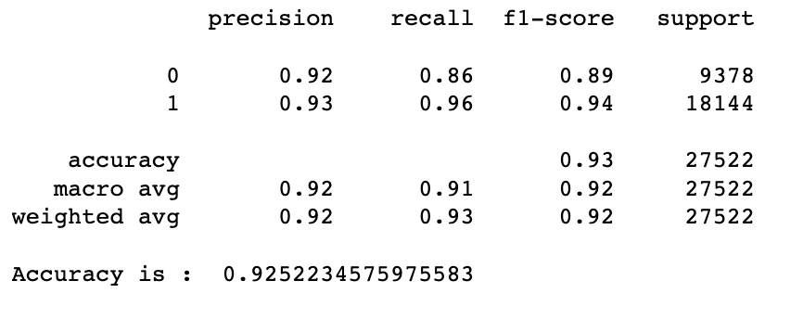
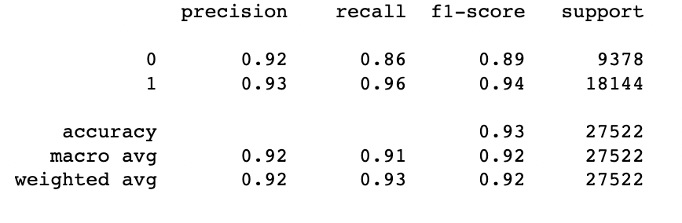
Random Forest
Accuracy of Training data set is 95%
Accuracy of test data set is : 92%
f1-score for train and test set is 0.96 and 0.93 respectively , which implies that this is a good model. Hence moving forward with this as final model for prediction.

Slide 17
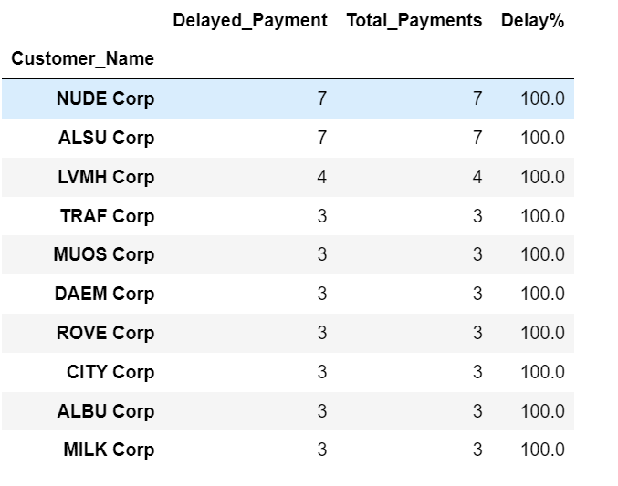
Conclusion
We have got two models Logistic Regression and Random Forest predicting different probability values for a customer to have a late payment.
It is observed that Random forest is performing much better than logistic regression. We can utilize this model and make pre-emptive calls to the customers to have them pay their invoice amounts on time.
According to the prediction, companies in the right table has maximum probability to default with maximum number of delayed payments. These companies should be focused more.

Slide 18
Business Insights/Recommendations
Credit Memo invoice class observed the high delay rate compared to Debit Memo or Invoice type invoice classes, hence company policies on payment collection could be made stricter around CM class.
Goods type invoices had significantly higher payment delay rates than non-goods types and hence can be subjected to stricter payment policies.
In the 2nd half of the year, late payments are observed to increase steeply from 7th months onwards even if the number of invoices are low. Company employees can pay more attention to actively chase customers to make payments.
Customer segments were clustered into three categories, viz., 0,1 and 2 which prolonged, early and medium payment duration respectively. It is observed that customers in cluster 0 (prolonged days) had significantly higher delay rates than early and medium days of payment, hence cluster 0 customers should be paid extensive focus

Slide 19
Thank you!

